Slide 1

Session 2.1
XPath

Slide 2

Topics
Covered
XPath Introduction
XPath Nodes
XPath Syntax
XPath Axes

Slide 3
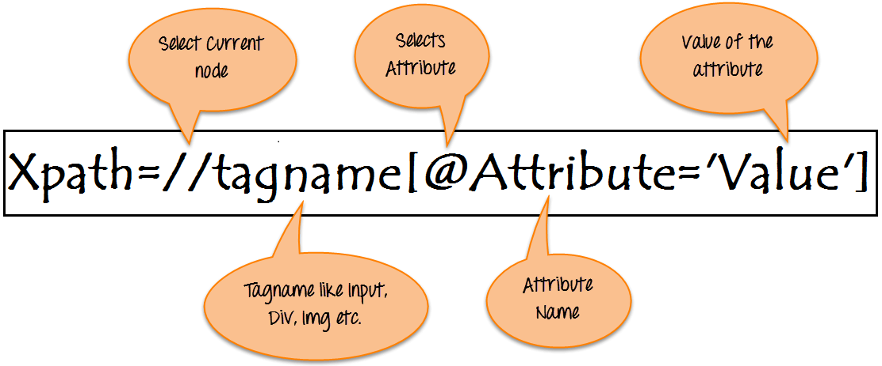
XPath
Introduction
XPath is defined as XML path. It is a syntax or language for finding any element on the web page using XML path expression.

Slide 4
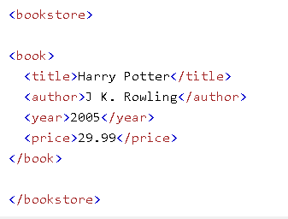
XPath Nodes
XML documents are treated as trees of nodes. The topmost element of the tree is called the root element.
Relationship of Nodes:
  Parent
  Children
  Siblings
  Ancestors
  Descendants

Slide 5
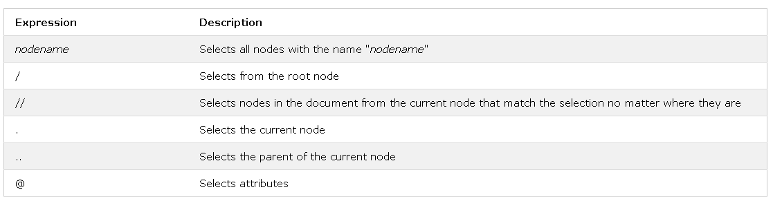
XPath Syntax
XPath uses path expressions to select nodes or node-sets in an XML document. The most useful path expressions are listed below:

Slide 6
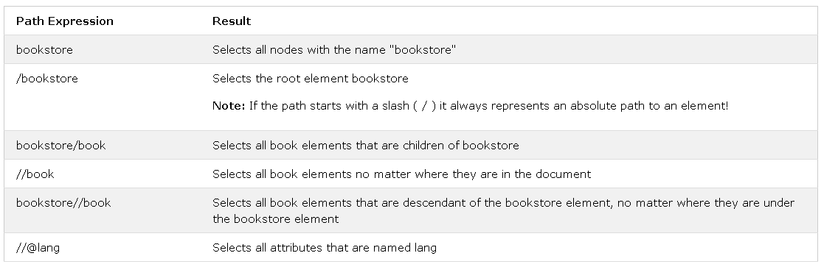
XPath Syntax

Slide 7
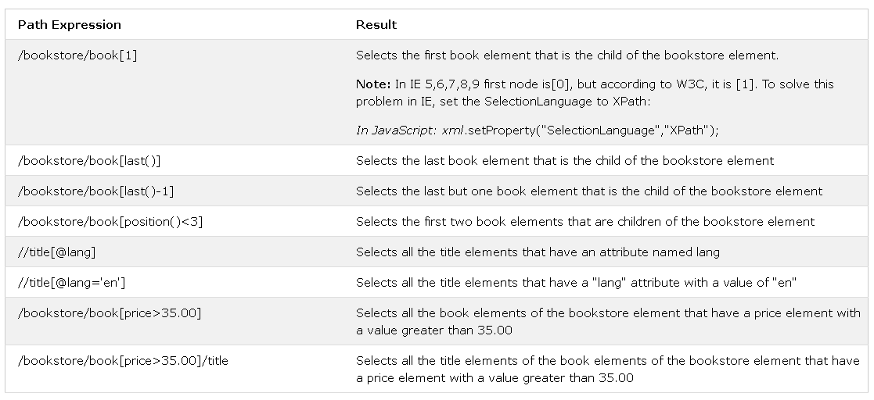
XPath Syntax
Predicates:
  Predicates are used to find a specific node or a node that contains a specific value.
  Predicates are always embedded in square brackets.

Slide 8
XPath Syntax
Selecting Unknown Nodes:
  XPath wildcards can be used to select unknown nodes.

Slide 9
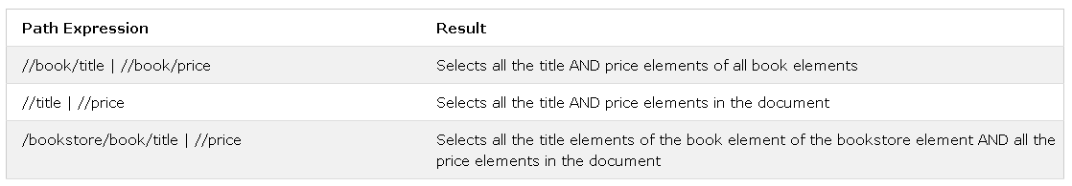
XPath Syntax
Selecting Several Paths:
  By using the | operator in an XPath expression you can select several paths.

Slide 10
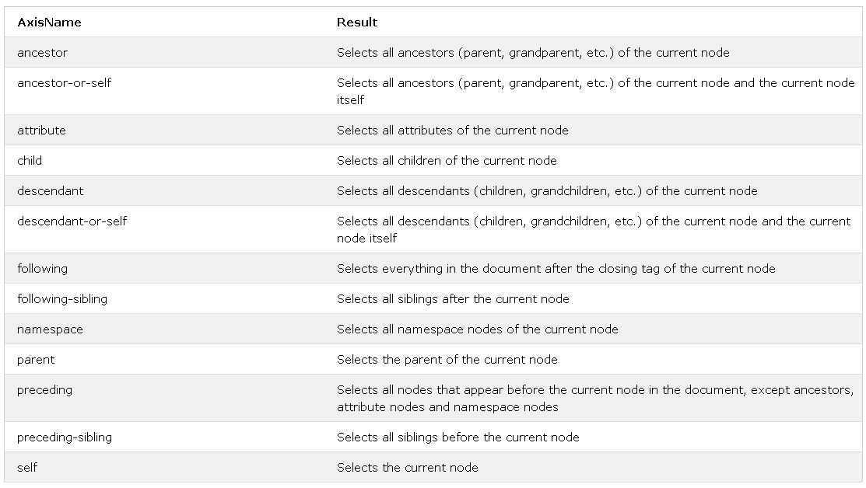
XPath Axes

Slide 11


Slide 12
Knowledge Check
What is XPath?
Type of Nodes in XPath?
Is it possible to have one XPath for the identification of 2 elements?
What is XPath Axes?

Slide 13

Thank you!

